Slide 1

Year 12 and 13 Scholars Programme

Slide 2
Firstly….Welcome and Well Done!

Slide 3
Expectations:
You must involve yourself in an academic co-curricular activity- Debating, MUN, Public Speaking, STEM
(resource list at end of PowerPoint)

Slide 4

You need to watch one Brilliant Club video a half-term:
https://www.youtube.com/channel/UClTv15xDz5kkhRcYDRiDD-g/videos

Slide 5
Read
Read a book from one the Gordon's wider reading list below (3 points)
Read 'A Very Short Introduction' book (3 points)
Read one resource from HE+ to extend learning (2 point)
Read academic article and write down findings (bullet point is fine) (2 points)

Slide 6
Watch
Watch a Masterclass from the Brilliant Club ( 1 point)
Watch Ted Talk and write up 3 questions (1 point)
Watch a documentary on your topic (2 points)

Slide 7
Involve
Take part in a School or online competition (4 points)
Visit Educational Setting or attend a lecture (can be online) (2 points)
Complete a MOOC course (4 points)
Attend a Cambridge Masterclass (4 points)
Host a Discussion Group - hold a meeting with to discuss idea / Hold a 'working party’ (4 points)

Slide 8
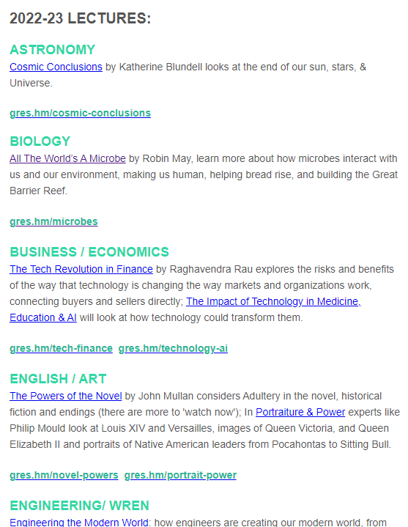
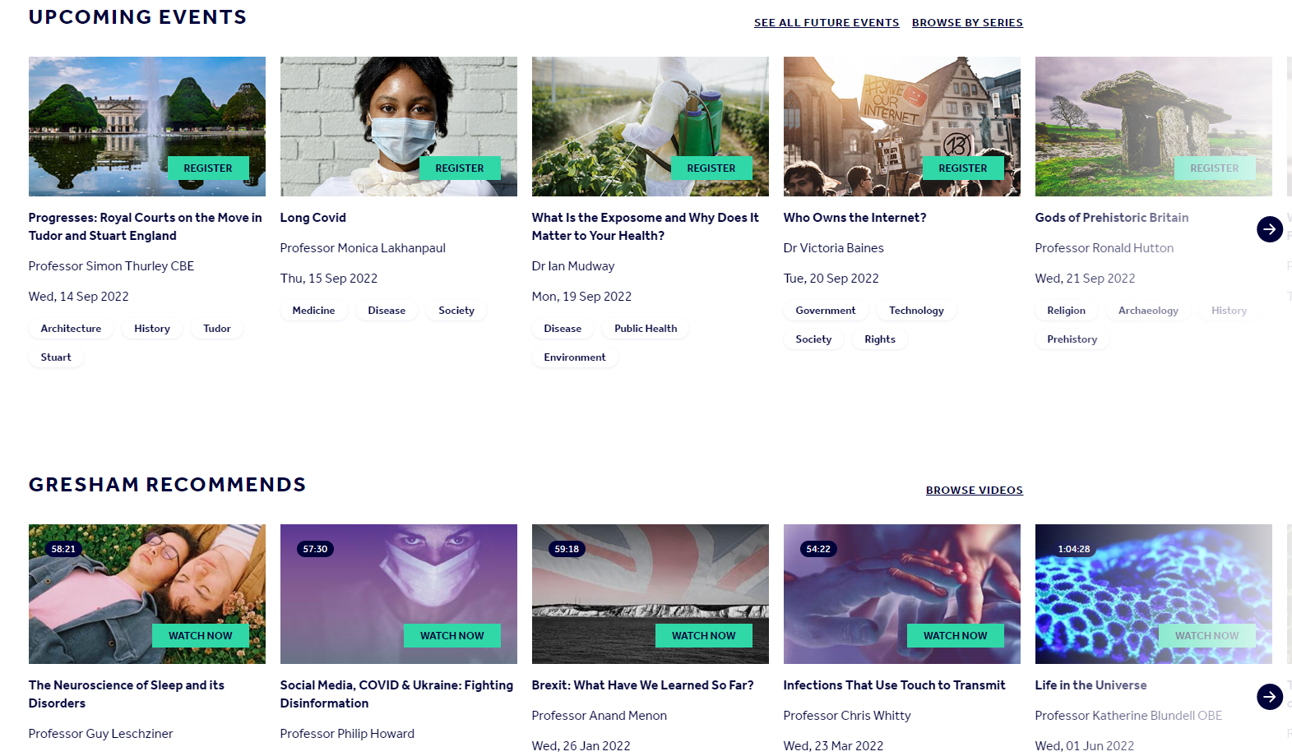
Gresham Lectures: watch or attend one each term
https://www.gresham.ac.uk/
Gresham offer exciting lectures both in person and to watch online. Browse the list and choose – ranges in topics!

Slide 9
Oxbridge Candidates
MUST read a book from resource list for chosen subject each half-term and write small review.
MUST choose a resource to study from the Oxford subject specific resource and write review of resource and how it extended learning

Slide 10
Medicine Candidates
Medical Candidates: Must read at least one journal a week from BMJ

Slide 11
To Note:
Meetings will be arranged with Miss Weeks or Mrs Wright (Oxbridge) to reflect and discuss progress.
If you are struggling to come up with an activity in your subject, let Miss Weeks know and she can provide a range of options
Keep a log of the activities completed, need to be able to discuss with Miss Weeks at meetings.

Slide 12
Resource List:
Gordon's Wider Reading List
Oxford University Suggested Subject Resources
Cambridge Subject Resources - rage in activity and sort resources by subject
MOOC online courses
Oxford University Reading Bank

Slide 13
Competitions… only a few!
Speak to Miss Weeks or your Departments for more!
https://www.gresham.ac.uk/schools-and-colleges/gresham-competition
https://www.studentladder.co.uk/year-12/entering-competitions/
https://www.bankofengland.co.uk/education/competitionshttps://www.ox.ac.uk/admissions/undergraduate/applying-to-oxford/teachers/academic-competitions-schools-and-colleges
https://www.mindsunderground.com/top-choice-competitions
Author of Tomorrow (will be 2023)
STEM: https://www.stem.org.uk/cyber-centurion#what-is-cybercenturion
STEM: https://www.ciwem.org/news/2022-uk-junior-water-prize
Biology: https://www.rsb.org.uk/education/teaching-resources/secondary-schools/school-competitions
Chemistry: https://saltersinstitute.org/
Science: https://oxsci.org/schools/
History: https://www.history.org.uk/secondary/categories/secondary-competitions
Gardening: https://schoolgardening.rhs.org.uk/School-gardening-awards
WRITING: https://schoolreadinglist.co.uk/competitions-for-children/childrens-writing-competitions/

Slide 14
Any further ideas or evidence of your learning?

