Slide 2
“Without mathematics, there’s nothing you can do. Everything around you is mathematics. Everything around you is numbers.”
Shakuntala Devi, Indian writer and mathematician
You are often told by your teachers and your parents that mathematics underpins everything we see and do in the world, so its important to work hard and make sure you get decent grades in the subject. But have you ever stopped to think more deeply about that Maths that goes into the little things you enjoy most every day? How the diameter of a football affects the amount of spin and curl you can generate when you kick it, for example? Or how the spiral patterns of seeds on a beautiful sunflower are vital to maximising its surface area, and hence its chances of reproduction?
In this competition you will get the opportunity to explore some of the mathematics in sport, nature and music, as well as showing us your creative skills.
End of year prizes can be won in this competition!

Slide 3
Your task
Research and present your findings on the real life mathematics that can be found in one of the following areas:
Mathematics in Sport
Mathematics in Nature
Mathematics in Music
You can present your research in the form of a fact sheet, powerpoint presentation or a video. You may work alone, in a pair or in a small group.
To see some ideas and get some inspiration, check out the videos on the following page.

Slide 4
Some inspiration / ideas from other students:
The mathematics behind rowing formations: https://www.youtube.com/watch?time_continue=4&v=IYxTaJpWzUo&feature=emb_logo
Projectile motion of a football:
https://www.youtube.com/watch?v=YJ01jojqyCw&list=PLTN2bMPwDm8bpVq9-wwgitStfPAXAIrUG&index=4&t=0s
Speed calculations in swimming:
https://www.youtube.com/watch?v=kXR9TXkic8Y&list=PLTN2bMPwDm8bpVq9-wwgitStfPAXAIrUG&index=5
Fractal patterns in the lungs:
https://www.youtube.com/watch?v=bReUlD8xNlw&feature=emb_logo
The Golden Ratio in nature:
https://www.youtube.com/watch?time_continue=1&v=IeoPU7321BM&feature=emb_logo
The geometry of beehives:
https://www.youtube.com/watch?v=5NmCuNapbXg&list=PLTN2bMPwDm8af1Bw7aZXwWYLIbSg4jrtv&index=5&t=0s

Slide 5
You may continue working on your research project over half term and you will also have some class time when we return to school to complete it.
If you would like to discuss your idea, or would like a bit more information, please contact Mr Eaden via email at meaden@gordons.school.
Some tips for creating videos, along with recommended apps, can be found on the next two pages. If you would like any more guidance on these, please contact Mr Watts at pwatts@gordons.school.
Good luck!

Slide 6
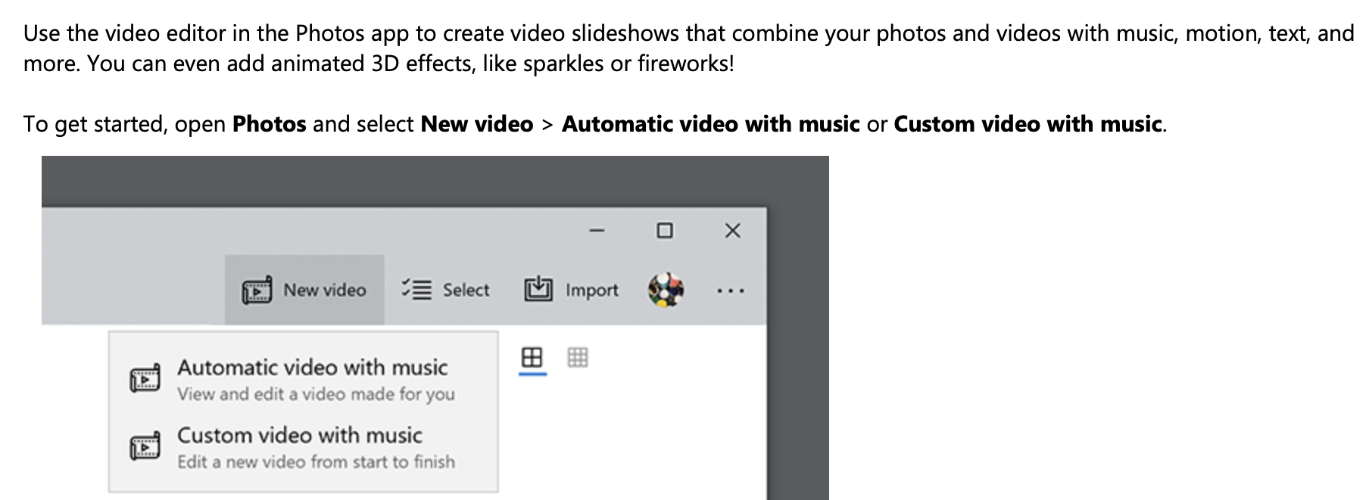
Once you have taken your photos & videos, here’s how you can create your own film:
Using a Mac, iPhone or iPad:
This is free software for Apple devices that can be downloaded from the App Store if it isn’t already installed.
There are plenty of guides to using this software on YouTube, including this one: https://www.youtube.com/watch?v=zR5USClbQZw
Using Windows 10:

Slide 7


Once you have taken your photos & videos, here’s how you can create your own film:
Online Video Editors:
Adobe Spark: https://spark.adobe.com/make/video-maker/
Clideo: https://clideo.com/video-maker
Biteable: https://biteable.com/tools/

