Slide 1
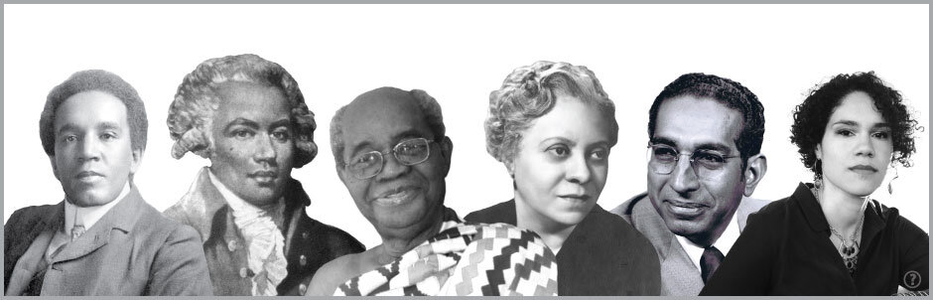
Rewriting musical history

Slide 2
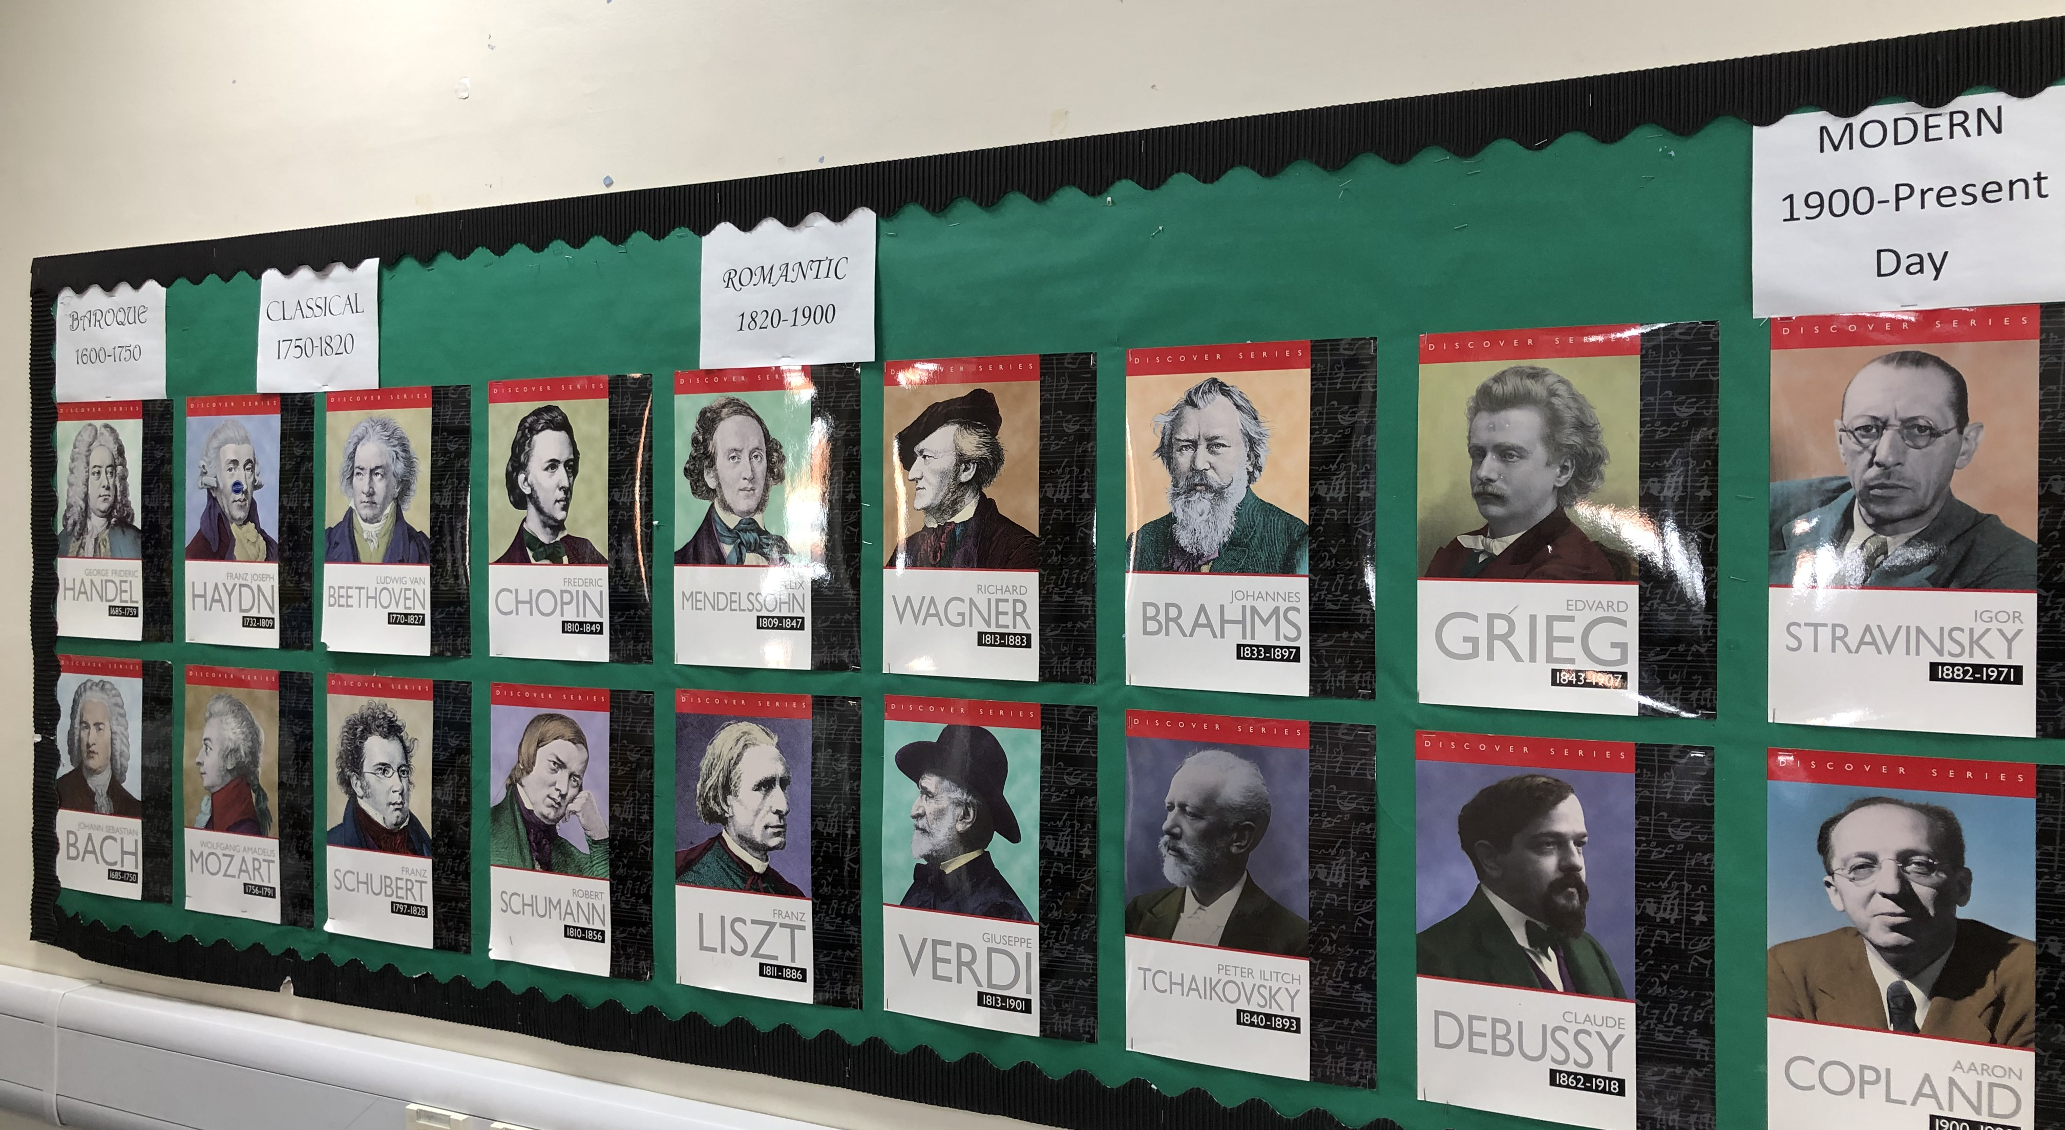
Pretty fly for a white guy
Look at this display of the most famous classical composers. What do you notice?
That’s right – all the pictures are of middle aged white men!

Slide 3
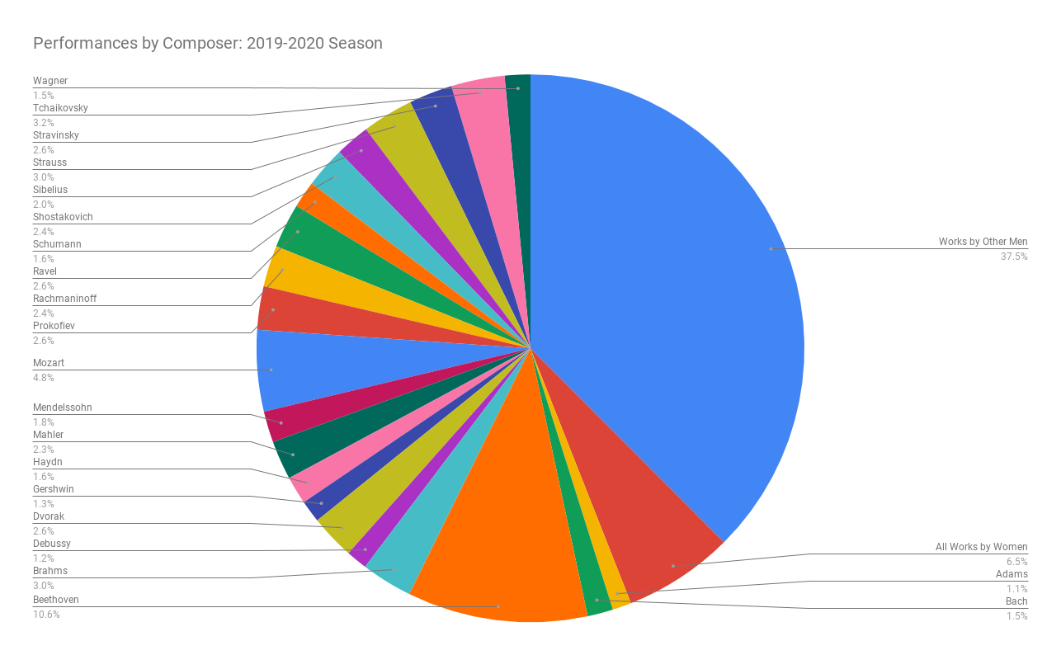
Where are the women?
This pie chart shows the percentage of music written by female composers that was performed was just 6.5% in the 2019-20 season
Take a think about why women may not be represented in this display?
Were they not interested in music?
Were they busy doing something else?
Or are there other reasons?

Slide 4
Women trailblazers
Watch this clip about an amazing female composer:
bbc.co.uk/teach/ten-pieces/classical-music-grazyna-bacewicz-overture/zf2k382
Now do some research on the following female composers:
Hildegard of Bingen 1098 –1179 Billy Holiday 1915-1959
Clara Schumann 1819-1896 Nina Simone 1933-2003
Fanny Mendelssohn 1805-1847 Ethel Smyth 1858-1944
Florence Price 1887-1953 Rachel Portman b. 1960
Hildur Guðnadóttir b. 1982 Judith Weir b. 1954
Germaine Tailleferre 1892-1983

Slide 5
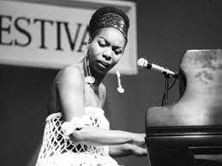
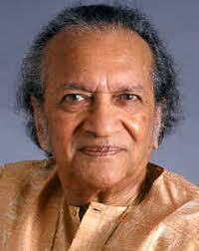
composers of colour
Music by people of colour was often very popular when it was composed, but in the twentieth century music by people of colour almost disappeared from concert programmes.
Watch this clip about how people of colour have been represented:
https://www.bbc.co.uk/programmes/p05ggdyw
Joseph Bologne Chevalier de Saint-Georges (1745-1799)
Scott Joplin (c.1868-1917)
Samuel Coleridge-Taylor (1875-1912)
Clarence Cameron White (1880-1960)
Florence Price (1877-1953)
Coleridge-Taylor Perkinson (1932-2004)
Wynton Marsalis (born 1961)
Billy Holiday (1915-1959)
Nina Simone (1933-2003)
Ravi Shankar (1920-2012)

Slide 6
Competition Time!
Prize available for 1st place!
Honourable mentions for 2nd and 3rd place

Slide 7
An inclusive concert for the 21st Century
It’s your turn to rewrite musical history.
Create your own suggested concert programme which shows off a range of composers from different genders, cultural backgrounds and musical periods.
Use some of the names on the powerpoint to get you started.
For each item on your concert programme, you need the following information:
Name of piece
Name and image of composer
A short biography of the composer
Your opinion about the piece, why you have chosen it and why it plays an important role in a diverse concert programme.
Your concert programme could be classical, popular, folk or a mixture of styles.
You can use any streaming service or YouTube to listen to their music.

Slide 8

An inclusive concert for the 21st Century
Use your newly acquired knowledge to create a concert programme which does the following:
Lists the composers and titles of the pieces in the order of performance
Gives some information about each composer
Gives some information about each piece
Submit your leaflet to the following email address by the closing date
Email: Competitions@gordons.school
When you email, please use the subject heading ‘KS3 Week 13 – Rewriting Musical History’
Closing date: 9am 21st May 2021
Winners will be announced via weekly Schoolcomms

