Slide 1
rewriting musical history

Slide 2
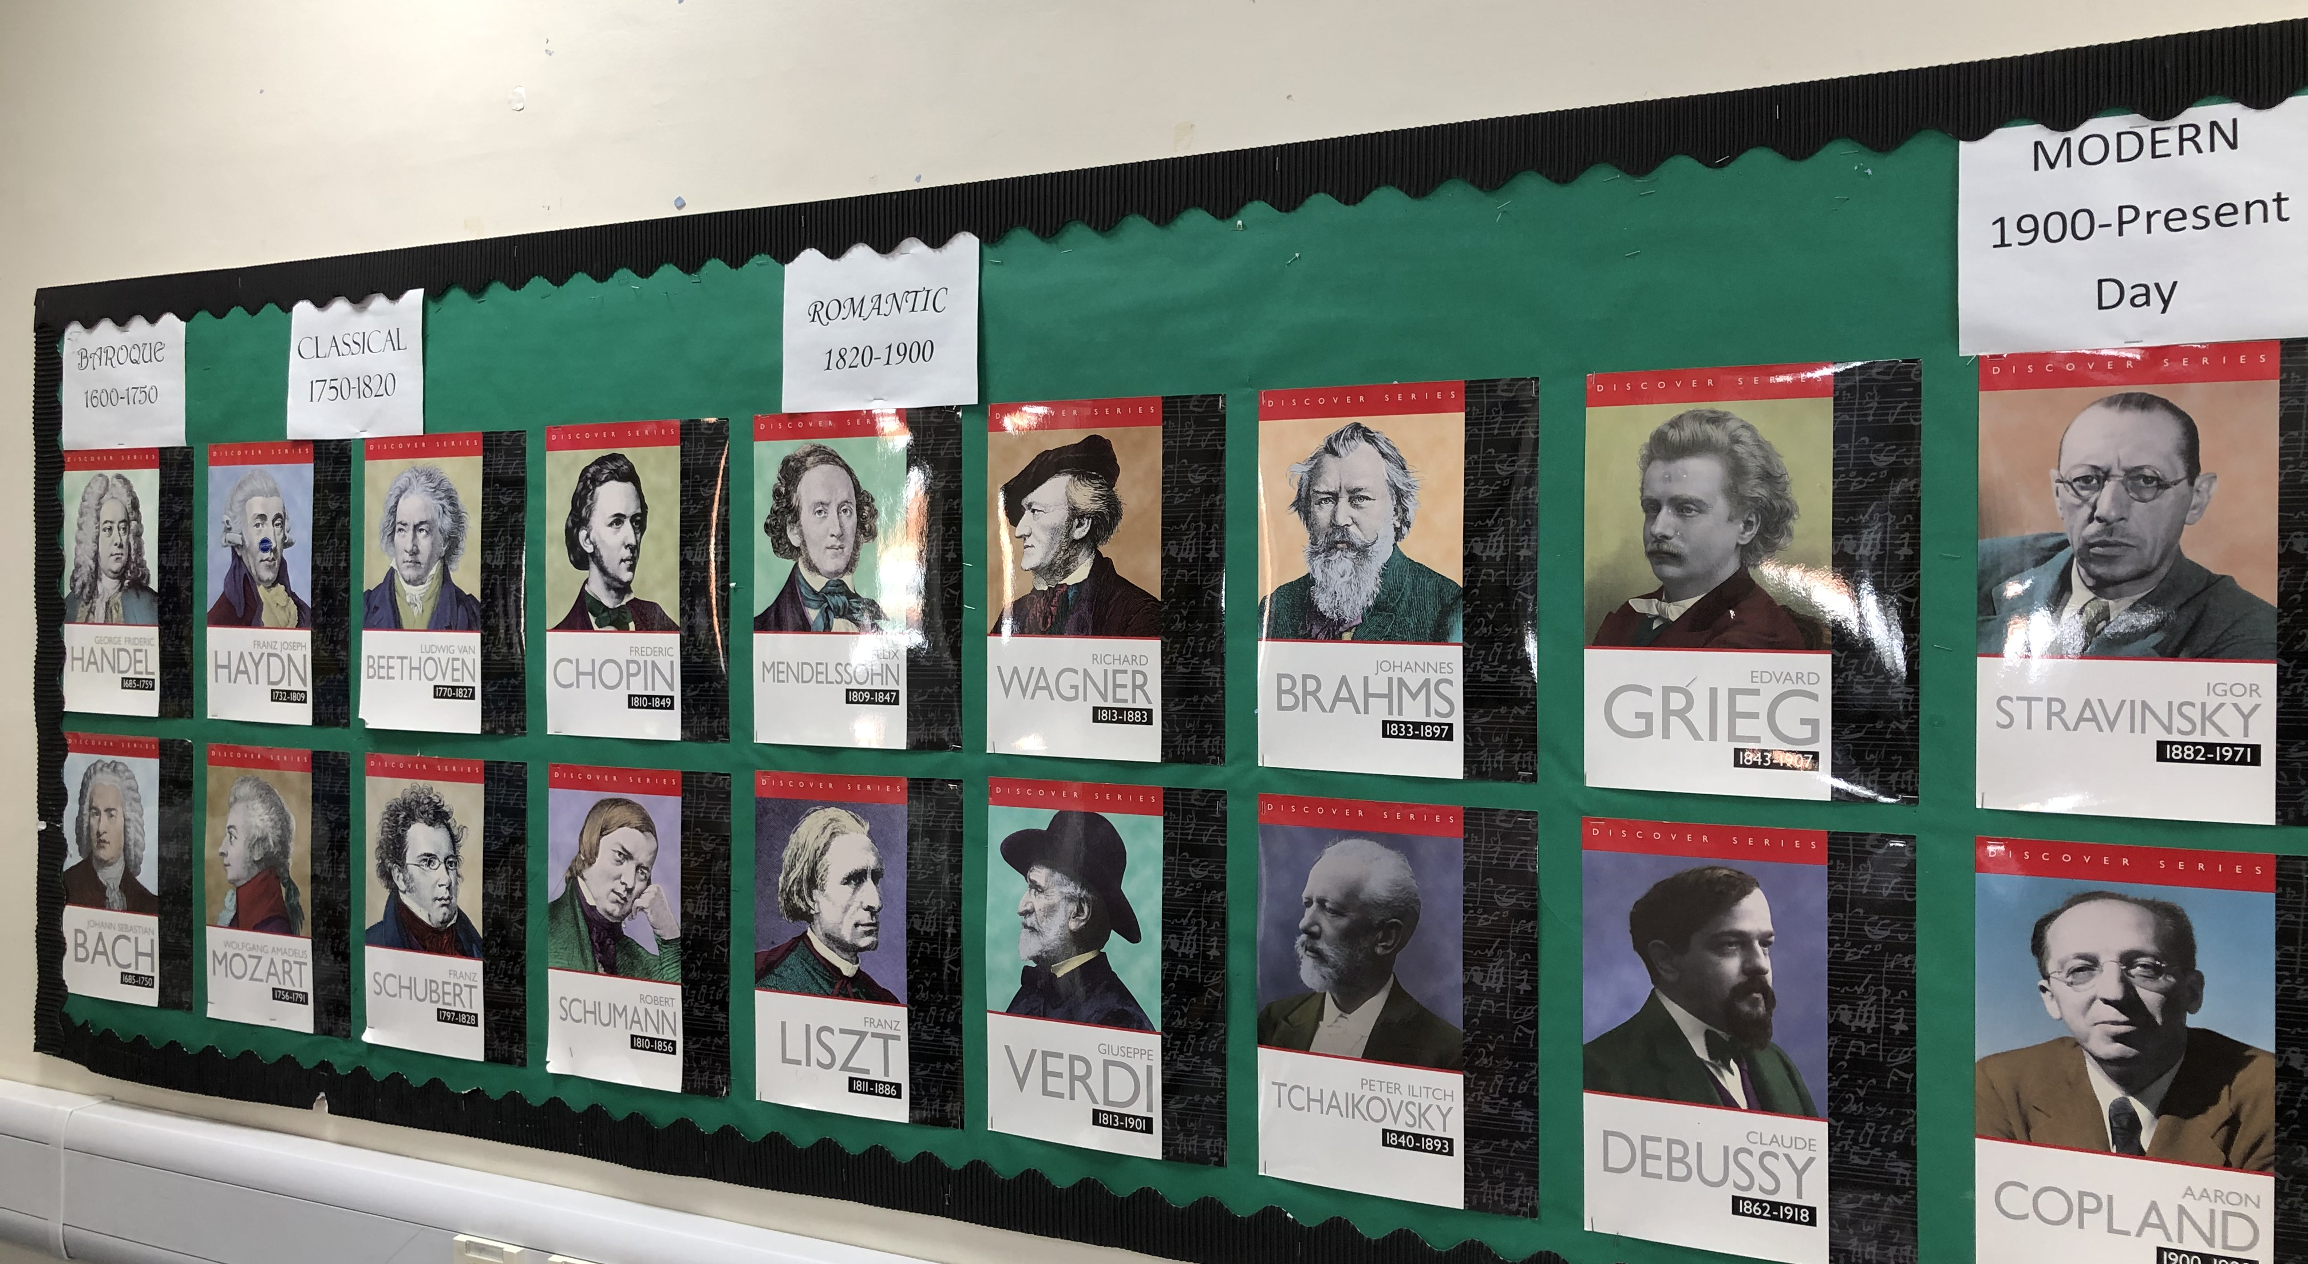
Pretty fly for a white guy
Look at this display of the most famous classical composers. What do you notice?
That’s right – all the pictures are of middle aged white men!

Slide 3
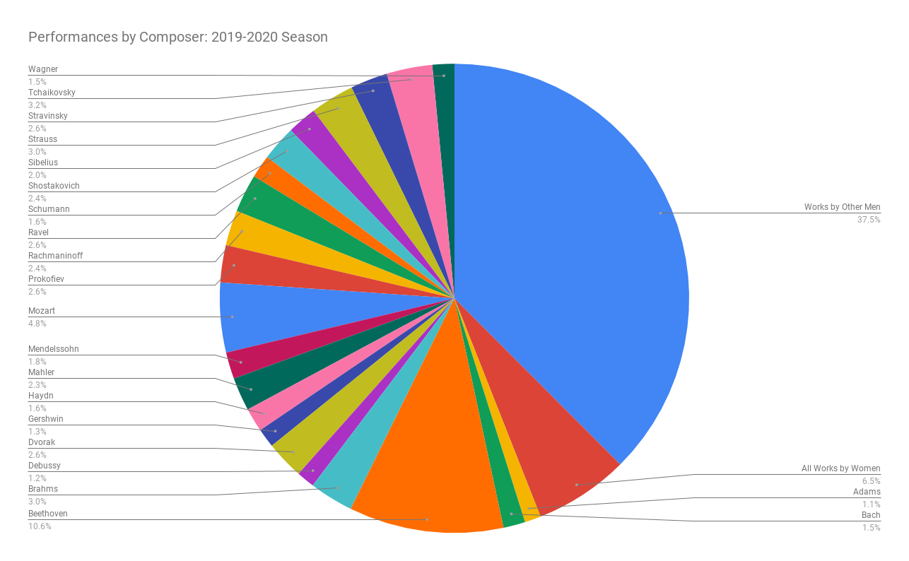
Where are the women?
This pie chart shows the percentage of music written by female composers that was performed was just 6.5% in the 2019-20 season
Take a think about why women may not be represented in this display?
Were they not interested in music?
Were they busy doing something else?
Or are there other reasons?

Slide 4
Women trailblazers
Watch this clip about an amazing female composer:
bbc.co.uk/teach/ten-pieces/classical-music-grazyna-bacewicz-overture/zf2k382
Now do some research on the following female composers:
Hildegard of Bingen 1098 –1179 Billy Holiday 1915-1959
Clara Schumann 1819-1896 Nina Simone 1933-2003
Fanny Mendelssohn 1805-1847 Ethel Smyth 1858-1944
Florence Price 1887-1953 Rachel Portman b. 1960
Hildur Guðnadóttir b. 1982 Judith Weir b. 1954
Germaine Tailleferre 1892-1983

Slide 5
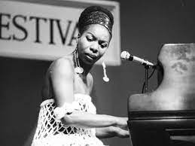
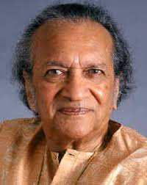
composers of colour
Music by people of colour was often very popular when it was composed, but in the twentieth century music by people of colour almost disappeared from concert programmes.
Watch this clip about how people of colour have been represented:
https://www.bbc.co.uk/programmes/p05ggdyw
Joseph Bologne Chevalier de Saint-Georges (1745-1799)
Scott Joplin (c.1868-1917)
Samuel Coleridge-Taylor (1875-1912)
Clarence Cameron White (1880-1960)
Florence Price (1877-1953)
Coleridge-Taylor Perkinson (1932-2004)
Wynton Marsalis (born 1961)
Billy Holiday (1915-1959)
Nina Simone (1933-2003)
Ravi Shankar (1920-2012)

Slide 6
Speaking out
In recent years, many people have started to speak out about the inequality of representation in concerts and in music education.
https://www.theguardian.com/world/2020/jul/15/uk-royal-schools-of-music-exam-board-urged-to-address-colonial-legacy

Slide 7
Protests
Female composers link
Black composer link

Slide 8
Competition Time!
Prize available for 1st place!
Honourable mentions for 2nd and 3rd place

Slide 9
It’s your turn to rewrite musical history.
Choose one task from the choice of three below:
1. Write a letter to the ABRSM exam board or one of the A level Music exam boards arguing why the inclusion of female composers and composers of colour is crucial to making music more inclusive in the 21st century.
2. Create a well structured concert programme which features composers that span a range of periods of musical history. You must include works by composers of different genders and cultural backgrounds. Your programme must include the following:
A statement on why a concert like this is needed.
A short biography of each composer
A musical analysis of each piece
3. Create your own TED Talk on this week’s theme – you can create your own title but it could be something like ‘Why music shouldn’t whitewash its history’ or ‘This girl can!’

Slide 10
Rewriting musical history
Submit your work to the following email address by the closing date
Email: Competitions@gordons.school
When you email, please use the subject heading ‘KS5 Week 13 – ‘Rewriting Musical History’
Closing date: 9am 21st May 2021
Winners will be announced via weekly Schoolcomms

